Slide 1
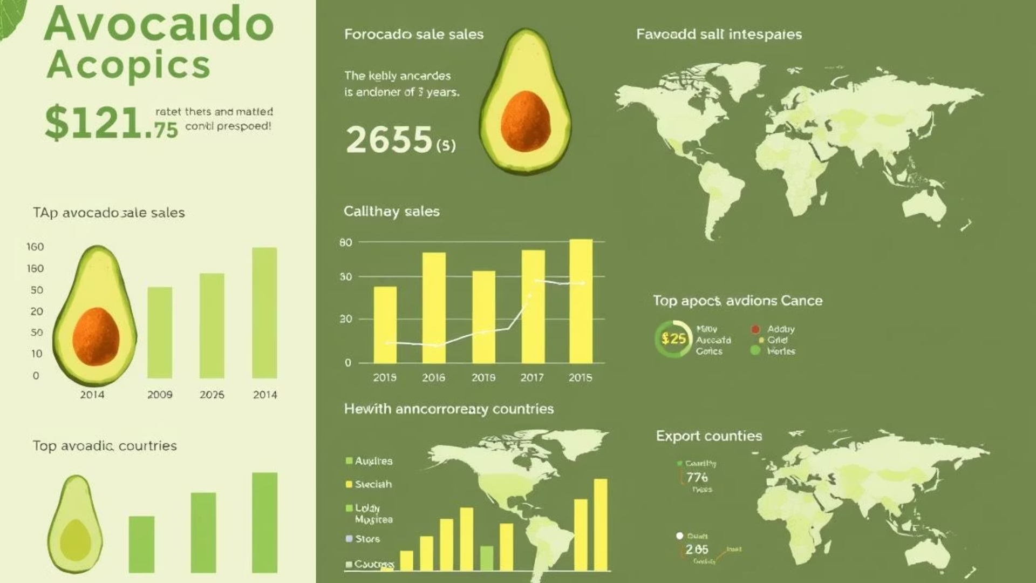

Final Project Presentation
Avocado Sales Volume Prediction
This project aimed to accurately forecast avocado sales volume using machine learning models, enabling data-driven inventory and marketing decisions. After thorough data preprocessing and exploratory analysis, we compared two main models: XGBoost optimized by Particle Swarm Optimization (PSO) and an LSTM neural network. The LSTM model outperformed XGBoost, achieving an R² score of 0.9209 on the test set. The final model was deployed via a FastAPI RESTful service, providing real-time sales forecasts accessible through a web interface.
by Abdelmoneim Adel

Slide 2

Introduction
Forecasting sales volume is critical for efficient supply chain management and customer satisfaction. This project focused on predicting avocado sales volume based on historical sales data spanning several years and geographic regions.

Slide 3
Data Collection and Preprocessing
Dataset Overview:
The data consists of sales records with features such as:
date: Date of the sales record.
average_price: Average price of avocados on that date.
total_volume: Total volume sold.
Codes like 4046, 4225, 4770: Representing different avocado sizes/types.
total_bags, small_bags, large_bags, xlarge_bags: Quantities of bags sold.
type: Avocado type (conventional or organic).
year: Sales year.
geography: Region of sales.
Preprocessing Steps:
Handling missing values using interpolation.
Encoding categorical features (type, geography) using one-hot encoding.
Feature engineering including extracting seasonal indicators from the date.
Normalizing numerical data to ensure scale uniformity.

Slide 4
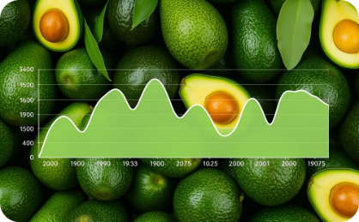
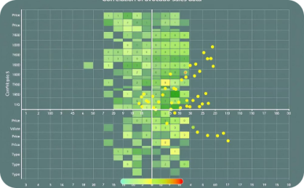
Exploratory Data Analysis (EDA)
Key insights identified:
Seasonal peaks in sales during holidays.
Variations in sales volume across regions and avocado types.
Correlations between price and sales volume trends.
Visual aids such as time series plots and correlation heatmaps were used to visualize these trends.
Seasonal Sales Patterns
Feature Correlations
Time series analysis revealed distinct seasonal patterns in avocado sales, with notable peaks during holiday periods throughout the year.
Correlation analysis between different variables helped identify key relationships, particularly between price fluctuations and sales volume.

Slide 5


Model Selection and Optimization
Two main models were tested:
XGBoost
LSTM
A powerful gradient boosting model, with hyperparameters optimized via Particle Swarm Optimization (PSO).
Long Short-Term Memory neural network, effective for capturing sequential dependencies in time-series data.
PSO Optimization Details:
Tuned parameters: number of estimators, max depth, learning rate, and subsample ratio.
The optimization process iterated through multiple candidate solutions to find the best hyperparameters, which were saved and reused for efficient model training.

Slide 6
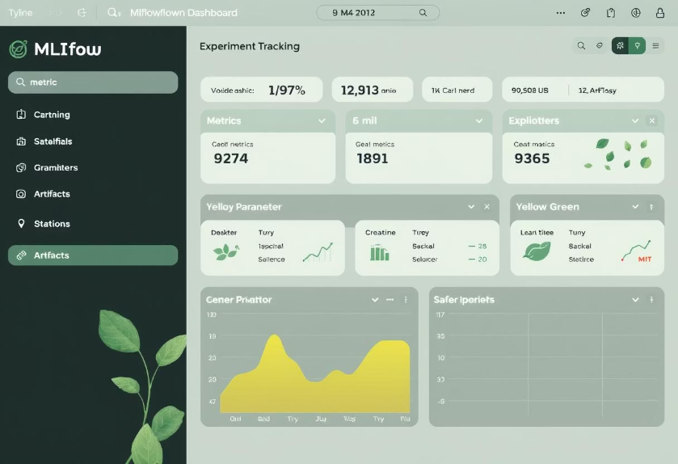
Experiment Tracking with MLflow
MLflow was used for:
Logging hyperparameters and model versions.
Tracking evaluation metrics (MSE, MAE, R²).
Storing artifacts like trained models and evaluation plots. This ensured reproducibility and easy comparison of experiments.
Benefits of MLflow
Using MLflow for experiment tracking provided several advantages:
Centralized storage of all experiment results
Easy comparison between different model configurations
Reproducibility of results
Efficient model versioning

Slide 7
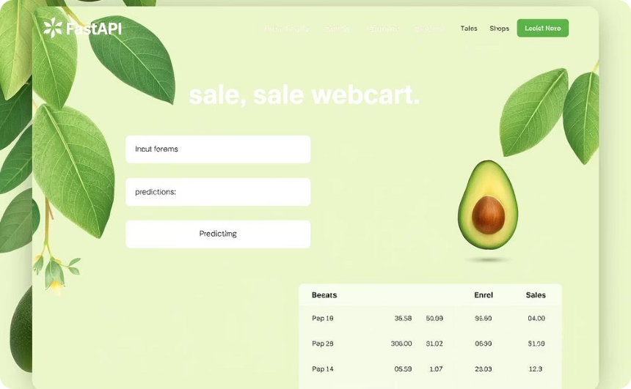
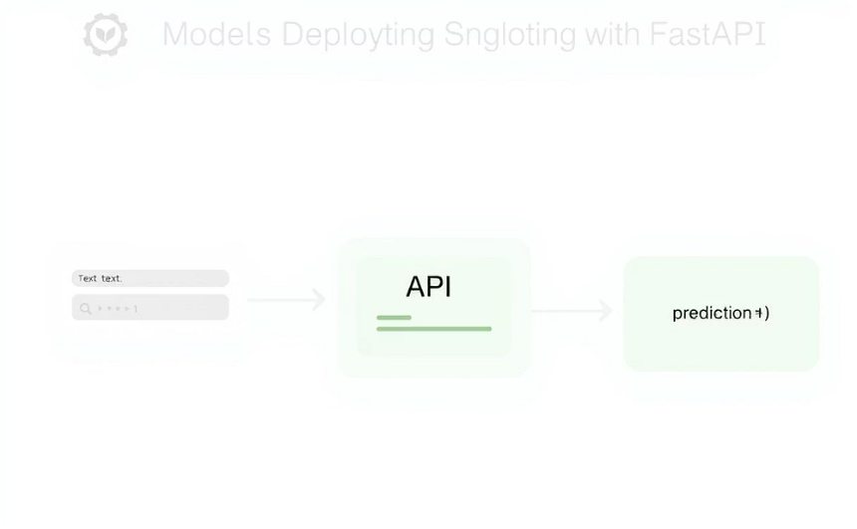
Model Deployment with FastAPI
The best model (LSTM) was deployed as a REST API using FastAPI, hosted on Railway. Users can input 30 past sales volume values to receive forecasts on either a linear or logarithmic scale.
API link: Avocado Sales Forecasting API
API Interface
Deployment Architecture
The FastAPI interface allows users to easily input historical data and receive sales forecasts in real-time.
The deployment architecture ensures efficient processing of requests and delivery of predictions through a RESTful API service.

Slide 8
Model Performance Comparison
The table below summarizes the evaluation metrics on the test set:
Model
MSE
MAE
R²
XGBoost (PSO)
2.22 × 10¹¹
198,852.97
0.8965
LSTM
1.69 × 10¹¹
169,825.36
0.9209
Final evaluation of the LSTM model:
MSE: 169,268,756,844.33
MAE: 169,825.36
R²: 0.9209
The LSTM model's superior R² score and lower error values demonstrate its effectiveness in capturing temporal dependencies in sales data.

Slide 9



Business Impact
Accurate forecasting enables:
Better inventory planning
Optimized marketing strategies
Increased customer satisfaction
Reduce stockouts and overstock situations through precise demand forecasting
Base campaigns on predicted demand fluctuations for maximum effectiveness
Ensure consistent availability of products when customers want them
Challenges and Solutions
Data Imbalance: Different regions and types had varying data densities; addressed with careful preprocessing and feature engineering.
Hyperparameter Optimization: PSO provided efficient tuning without exhaustive grid search.
Deployment: Integrating the model into a RESTful API with FastAPI ensured accessibility and scalability.

Slide 10

Tools and Future Work
Tools and Technologies
Future Work
Python for data processing and modeling.
Incorporate external economic indicators and weather data to improve forecasting.
Pandas for data manipulation.
XGBoost for gradient boosting model.
Explore other deep learning architectures such as Transformers.
TensorFlow/Keras for LSTM implementation.
Enhance the API with authentication and a user-friendly frontend interface.
MLflow for experiment tracking.
FastAPI for API deployment.
Railway for hosting the API.

Slide 11

Team Member
Abdelmoneim Adel Abdelmoneim
Kareem Mohamed Abdelmoneim
Eman Hassan Elqalioby
Esra’ Ehab
Thanks

Slide 12


